Slide 1

Chapter 3
CONDITIONAL EXECUTION

Slide 2
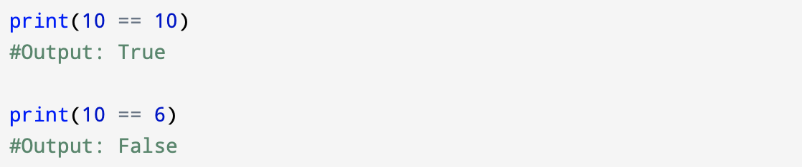
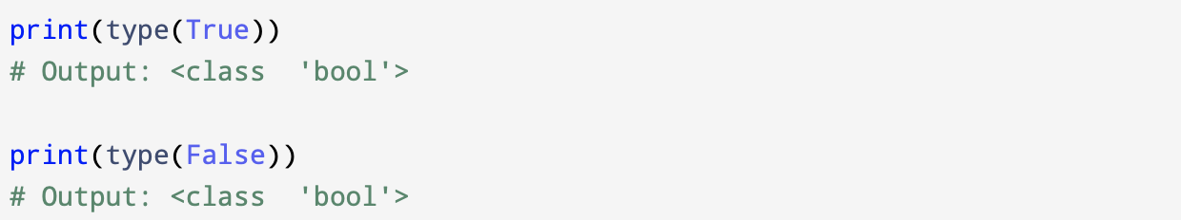
3.1 Boolean expressions
A boolean expression is an expression that is either true or false.
Examples below, use the operator ==, which compares two operands and produces True if they are equal and False otherwise:
True and False are special values that belong to the class bool; they are not strings:

Slide 3
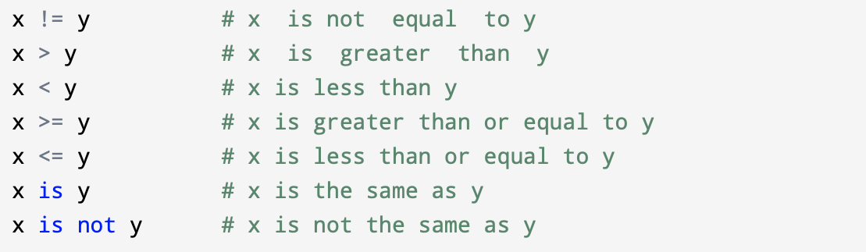
The == operator is one of the comparison operators; the others are:
Python symbols are different from the mathematical symbols for the same operations.
It is important to remember that = is an assignment operator and == is a comparison operator.
Also, There is no such thing as =< or =>
Using a single equal sign (=) instead of a double equal sign (==) is a very common error.

Slide 4
3.2 Logical operators
There are three logical operators:
and
or
not
The meaning of these operators is similar to the English semantic language.
For example:
x > 0 and x < 10
Is true only if x is greater than 0 and less than 10.

Slide 5
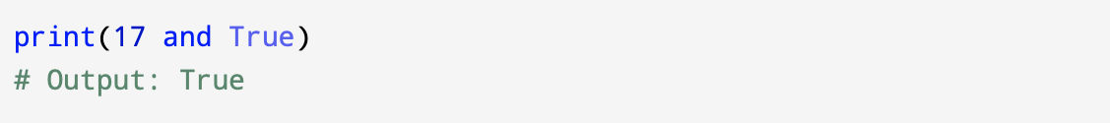
n%2 == 0 or n%3 == 0
Is true if either of the conditions is true, that is, if the number is divisible by 2 or 3.
The not operator negates a boolean expression, so not (x > y) is true if x > y is false; that is, if x is less than or equal to y.
The operands of the logical operators should be boolean expressions, but Python is not very strict. Any nonzero number is interpreted as “True”.
This flexibility can be useful, but there are some subtleties to it that might be confusing.
It is better to avoid them until you are sure you know what you are doing.

Slide 6
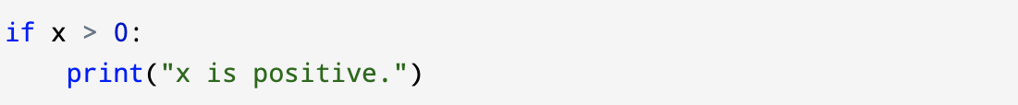
3.3 Conditional execution
Conditional statements give us ability to write useful programs.
We almost always need the ability to check conditions and change the behavior of the program accordingly.
The simplest form is the if statement:

Slide 7
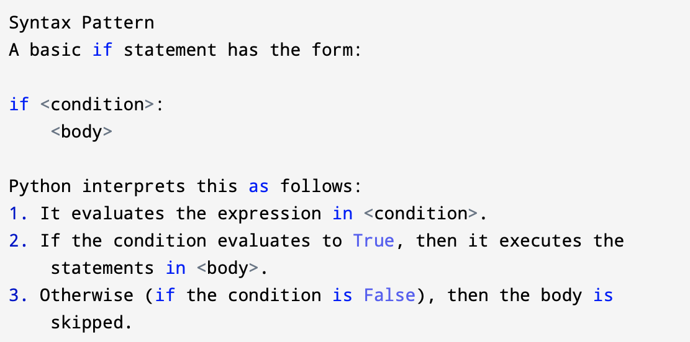
The boolean expression after the if statement is called the condition; here it is x > 0.
We end the if statement with a colon : and the line(s) after the if statement (we call that part body) are indented.

Slide 8
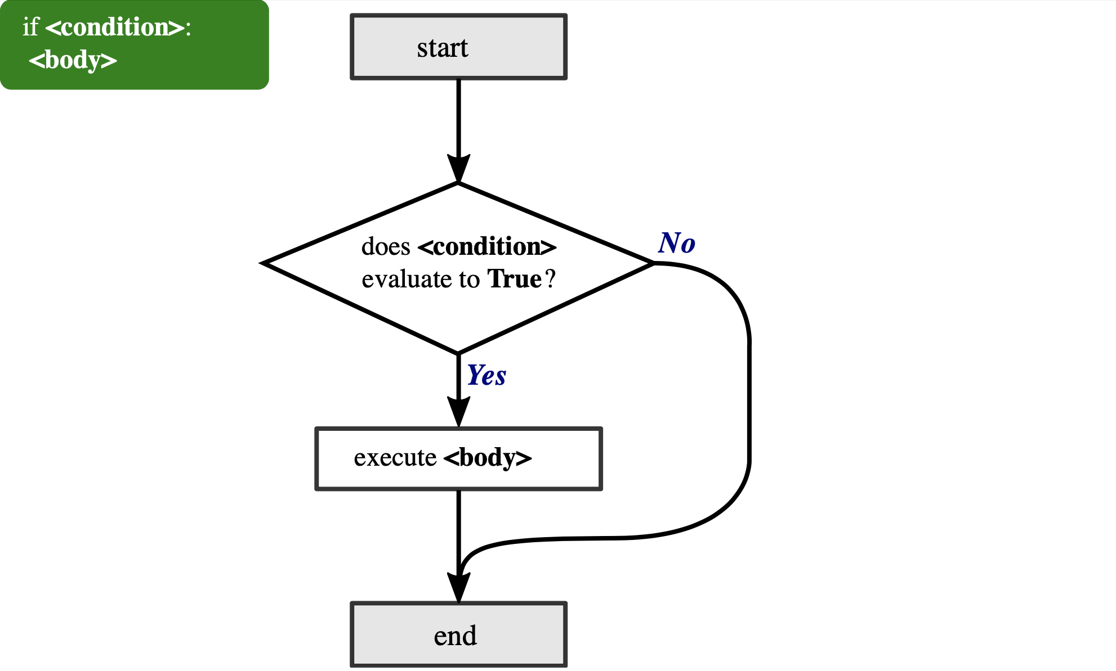
Figure1: Flowchart illustrating the execution of a basic if statement

Slide 9
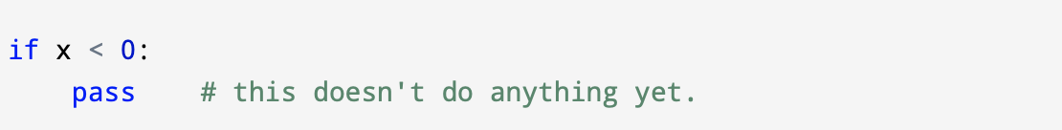
There must be at least one statement that appears in the body but there is no limit on the number.
Sometimes, it is useful to have a body with no statements (usually as a placeholder for code you haven’t written yet). In that case, you can use the pass statement, which does nothing.

Slide 10
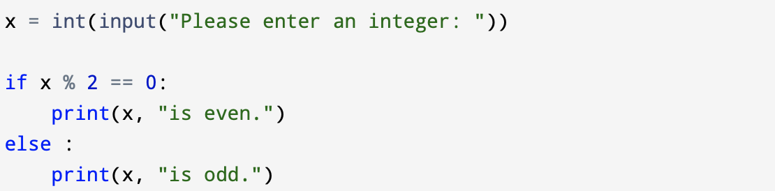
3.4 Alternative execution
If - else statement is a second form of the if statement and is an alternative execution in which there are two possibilities and the condition determines which one gets executed.
When x is divided by 2 is 0, then we know that x is even, and the program displays a message. If the condition is false, the indented block after the else line is executed.

Slide 11
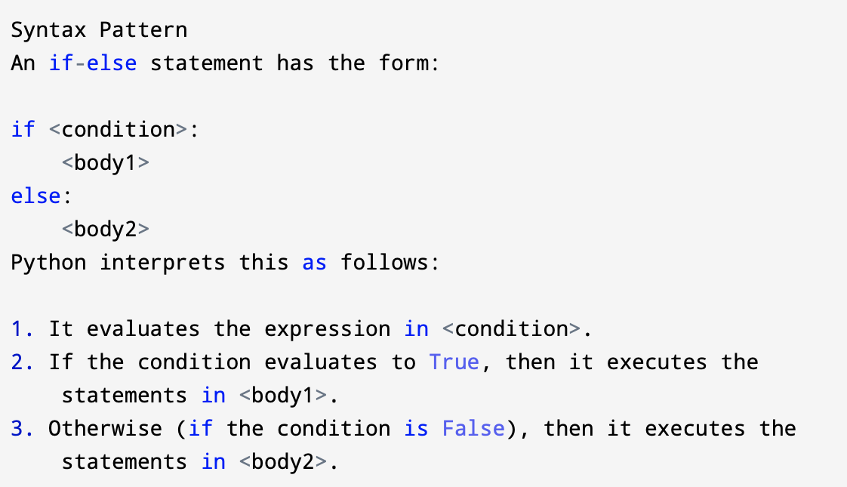

Slide 12
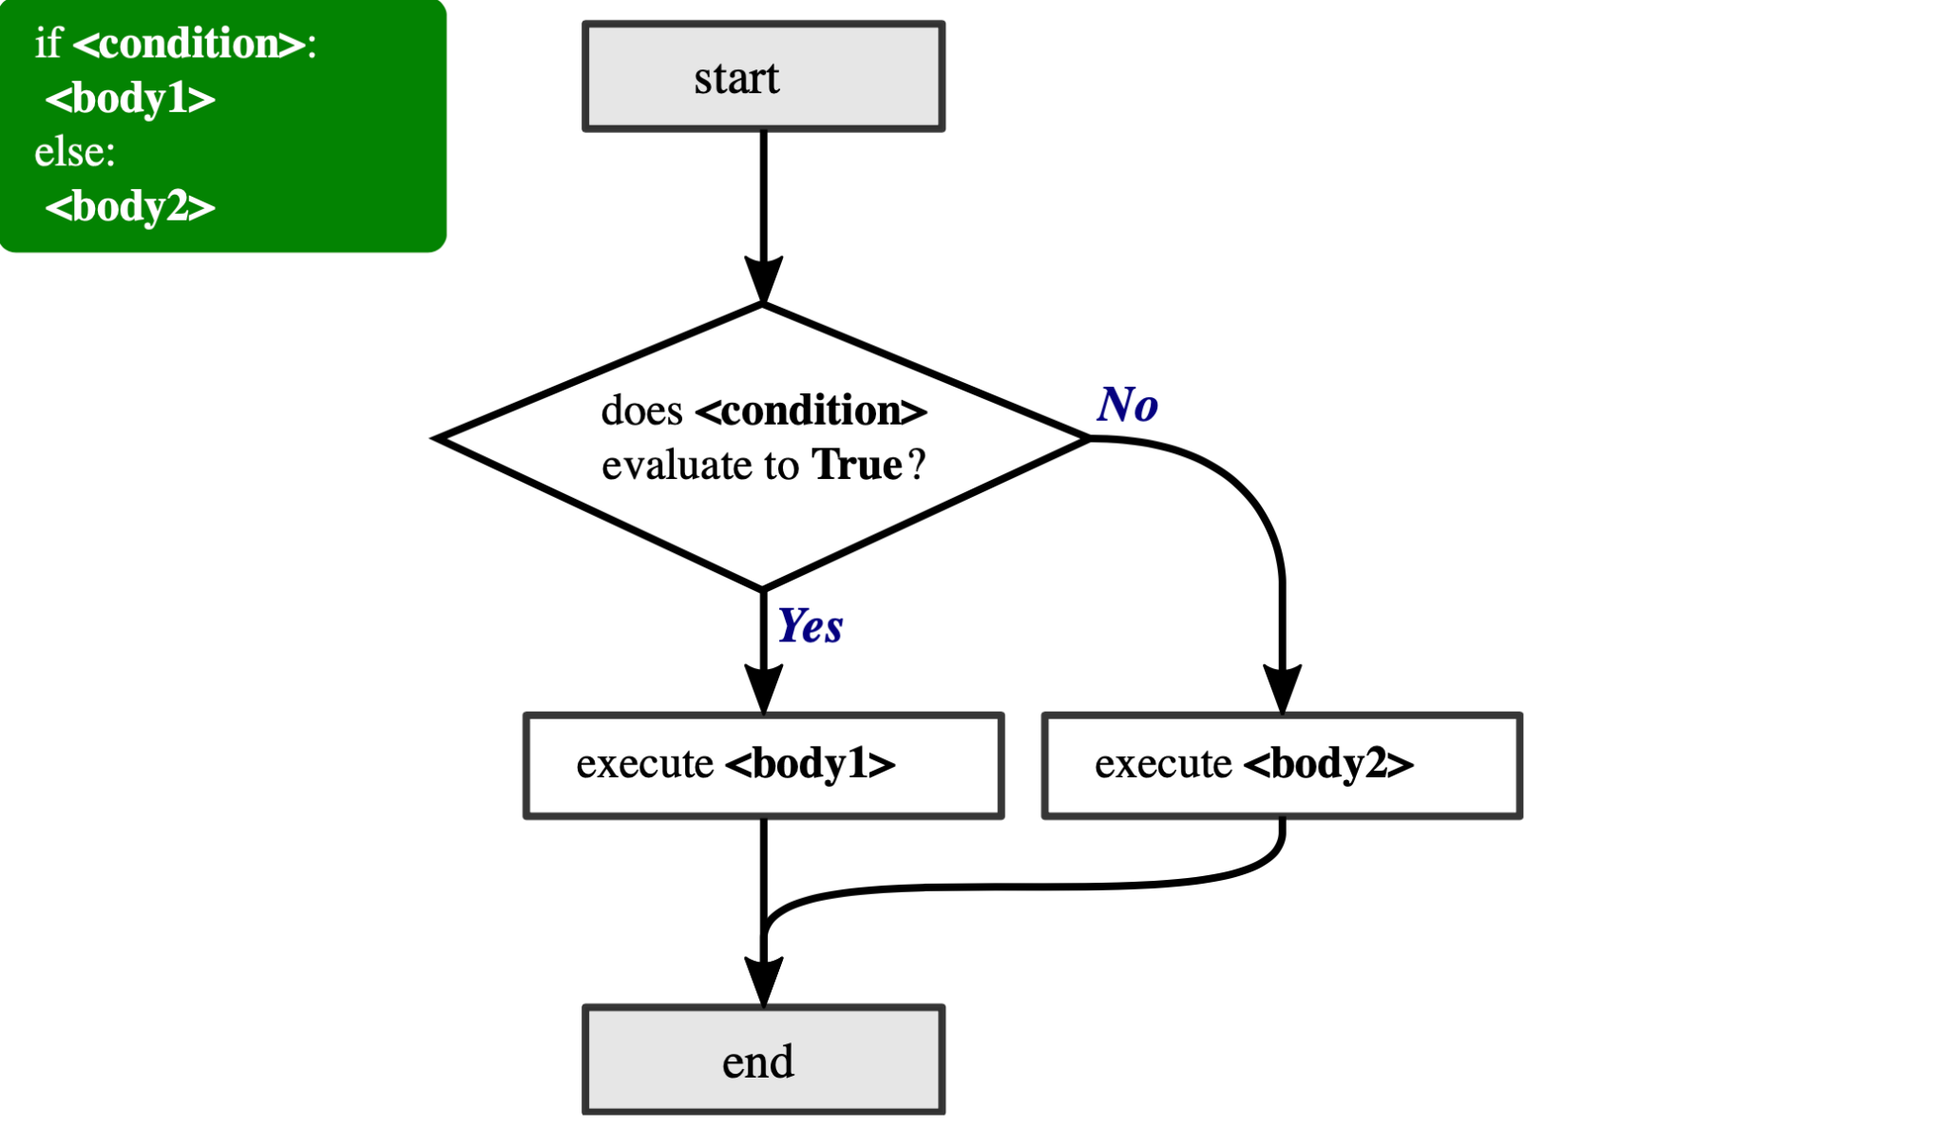
Figure 2: Flowchart illustrating the execution of an if-else statement.
​​The condition must either be true or false, exactly one of the alternatives will be executed. The alternatives are called branches, because they are branches in the flow of execution.

Slide 13
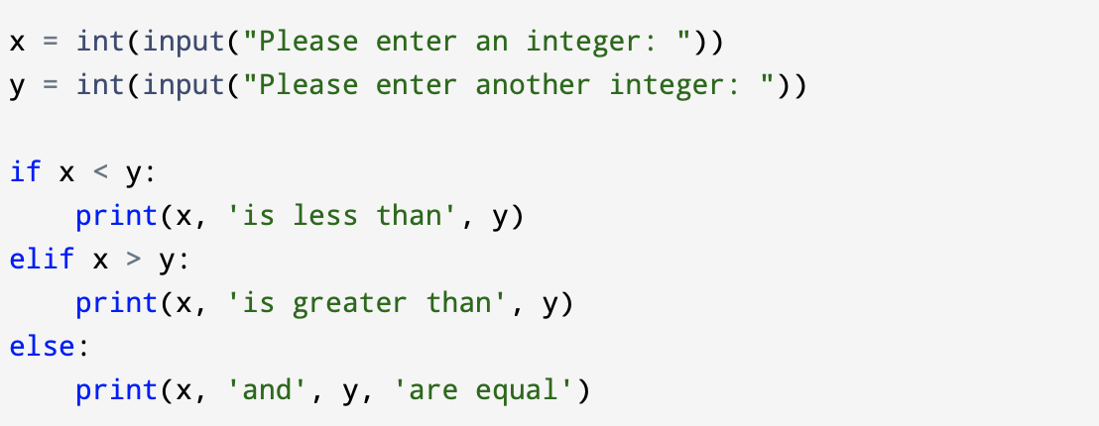
3.5 Chained conditionals
When there are more than two possibilities, we need more than two branches.
Chained conditional is the one way to express a computation like that.

Slide 14
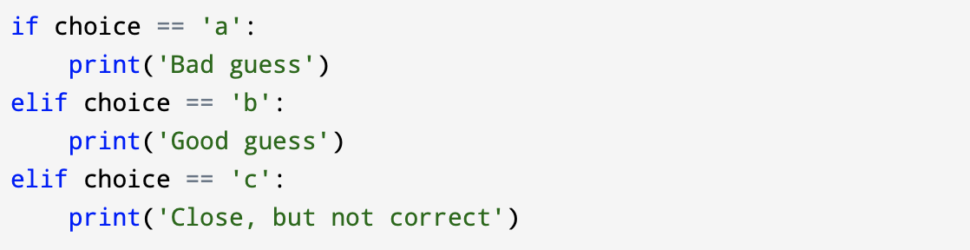
Elif is an abbreviation of “else if.” Again, exactly one branch will be executed.
There is no limit on the number of elif statements. If there is an else clause, it has to be at the end, but there doesn’t have to be one.
Each condition is checked in order. If the first is false, the next is checked, and so on. If one of them is true, the corresponding branch executes, and the statement ends.
Even if more than one condition is true, only the first true branch executes.

Slide 15
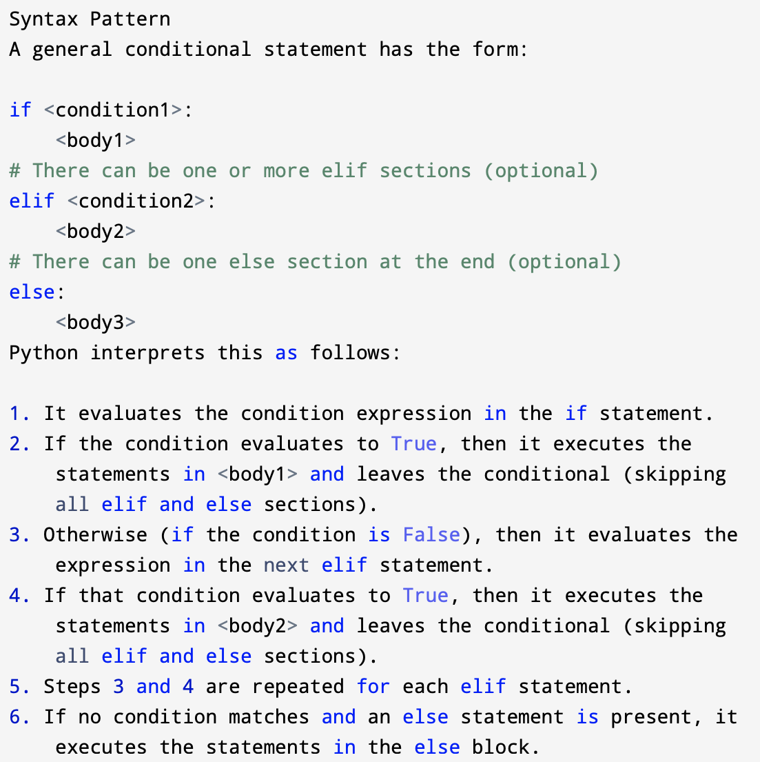

Slide 16
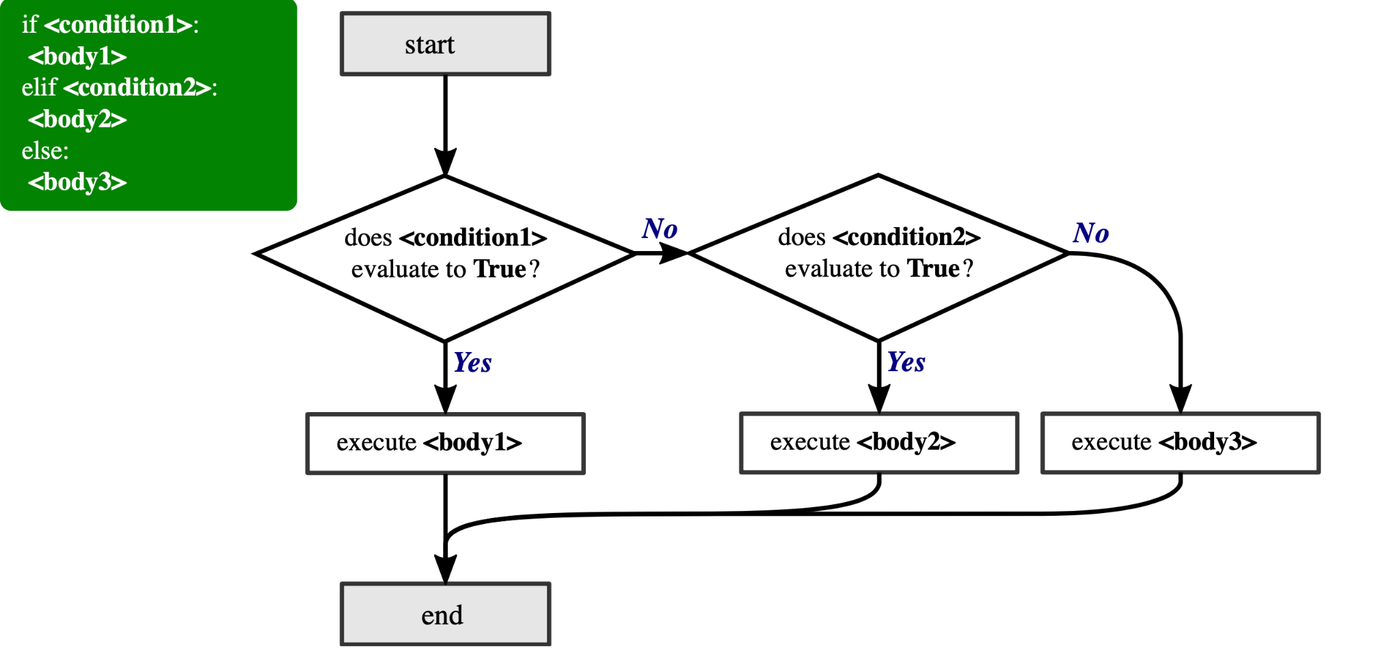
Figure3: Flowchart illustrating the execution of general conditional statement.

Slide 17
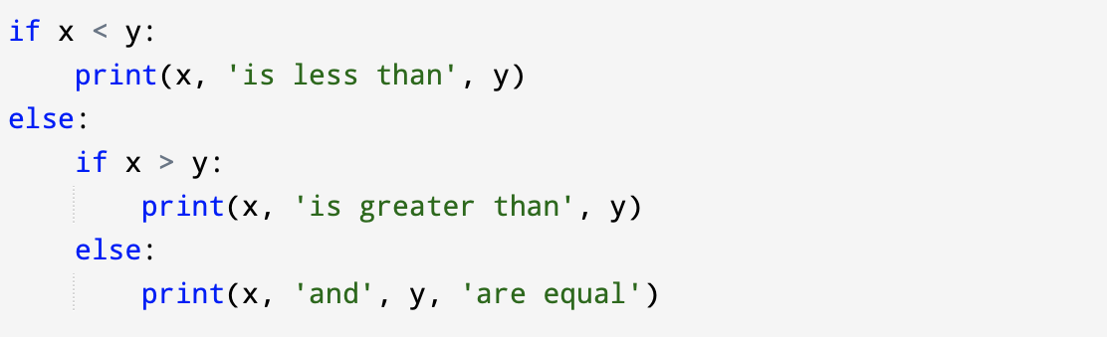
3.6 Nested conditionals
One conditional can also be nested within another. We could have written the three-branch example like this:
The outer conditional contains two branches. The first branch contains a simple print statement. The second branch contains another if statement, which has two branches of its own. Those two branches are both simple statements, although they could have been conditional statements as well.

Slide 18
The indentation of the statements makes the structure apparent. Sometimes nested conditionals become difficult to read very quickly. In general, it is a good idea to avoid them if you can. But don’t be afraid to put a for loop inside a conditional, or a conditional inside a for loop. It’s perfectly valid and quite common.

Slide 19
3.7 Catching exceptions using try and except
Error in Python can be of two types i.e. Syntax errors and Exceptions.
Errors are the problems in a program due to which the program will stop the execution. Also, exceptions are raised when some internal events occur which changes the normal flow of the program.
Common Exception Errors are :
IOError: if the file can’t be opened.
KeyboardInterrupt: when an unrequired key is pressed by the user.
ValueError: when built-in function receives a wrong argument.
EOFError: if End-Of-File is hit without reading any data.
ImportError: if it is unable to find the module.

Slide 20
There is a conditional execution structure built into Python to handle these types of expected and unexpected errors called “try / except”.
The idea of try and except is that you know that some sequence of instruction(s) may have a problem and you want to add some statements to be executed if an error occurs.
These extra statements (the except block) are ignored if there is no error.

Slide 21
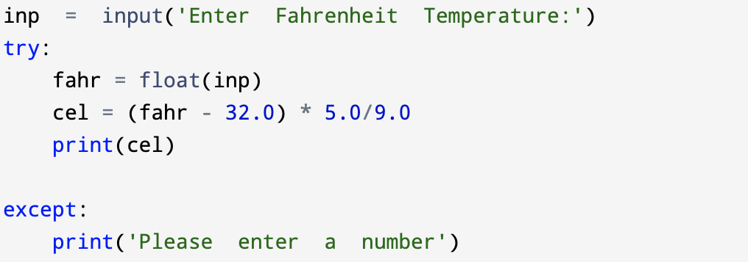
Example:
Python starts by executing the sequence of statements in the try block. If all goes well, it skips the except block and proceeds. If an exception occurs in the try block, Python jumps out of the try block and executes the sequence of statements in the except block.
Handling an exception with a try statement is called catching an exception.

